Slide 1
Ai-Powered Indian Travel Companion
ADIT, CVM University
102040601 – Mini Project
Semester - 6
Prepared By: Mr. Naitik Soni (12002080601065)
Mr. Tushar pankhaniya (12002080601112)
Guided By: Dr. Narendra Chauhan

Slide 2
Team Details
No. | Enrollment No. | Student Name | Role In Project
1 | 12002080601065 | Naitik Soni | Backend and AI(Frontend + Backend)
2 | 12002080601112 | Tushar Pankhaniya | UI design and Frontend
3 | 12002080601081 | Pratham Shah | Optimization, Testing, QA

Slide 3
Index
Problem Statement
Review of Related Work (if any)
Proposed Solution
Project Planning
Technology Stack (why)
UI Design (Figma Design)
Diagrams
Database Design
Revenue Model
Video
Project Demo

Slide 4
Problem Statement
Planning a trip to India can be a challenging and overwhelming experience due to the vastness and cultural diversity of the country. With so much to see and experience, visitors may find it challenging to navigate the best options and create an itinerary that meets their unique interests and preferences. This can lead to frustration, disappointment, and an unsatisfying travel experience, especially for first-time visitors to the country.
Target Audience: Travelers, Travel agencies and tourism industry ,
Holidaying family

Slide 5
Review
Airbnb: Calendar and messaging system, Places in maps, different places around user
Expedia: Gives activities, safety measures, activities search
Eddy travel: Travel chatbot, Visa and insurance
Iplan.ai: Calculation of time and Popular locations with description

Slide 6
Solution
Our AI-powered travel companion simplifies the process of planning and enjoying a trip to India by providing users with a range of functionalities through a website and mobile app.
User can search for flights, trains, buses, and hotels or use the "imagination search" to find new and exciting places to visit.
Additionally, the AI voice assistant can help users plan their trip according to their preferences, including budget, date, and specific cultural interests.

Slide 7
Solution
The travel assistant serves as a helpful guide throughout the journey, providing information about the location, nearby facilities and attractions, and can also help users find hotels and book flights, trains, and buses.
Users can also create a personalized travel journal to document their trip, including their best memories, photos, and other details.
the travel assistant provides translation services, medical and police information, and women's safety information to ensure a safe and enjoyable experience.

Slide 8
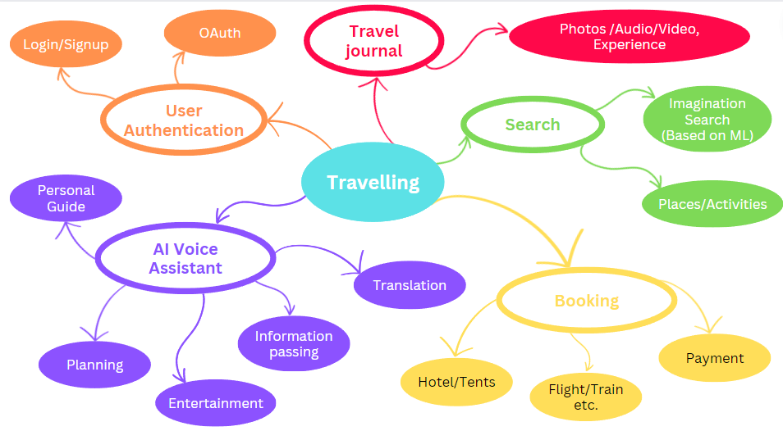

Slide 9
Project Planning
(1) Timeline
January | February | March
Weeks | 1 | 2 | 3 | 4 | 5 | 6 | 7 | 8 | 9 | 10 | 11 | 12 | 13
Developing Solution And Planning
UI design
Database design
Coding/ Programming
Testing and Optimization

Slide 10
Project Planning
(2) Work Distribution
Member | Work
Naitik Soni | Django application in backend, Database design, AI voice assistant, Creating RESTful APIs, NLP in speech, Authentication
Tushar pankhaniya | UI/UX design, Front end react development (Website + Mobile application), Payment gateway
Pratham Shah | Code Optimization, Testing the application and website

Slide 11
Technology Stack (why)
[1] Front end:
React js, React native, Ajax, Annyang js
Why?
Component based architecture
Virtual DOM
Declarative programming
App and Web interfaces with minimum effort
Dynamic data loading

Slide 12
Technology Stack (why)
[2] Back end:
Python, Django, MongoDB, REST
Why?
Easy to build architecture
Security and Authentication
Rapid prototype and scalability
MongoDB can handle unstructured and semi-structured data, such as text, audio, and images.
Serialization and Pagination

Slide 13
UI Design
UI Design Workflow ( Preferred In Figma Design )

Slide 14
Diagrams
UML Diagrams ( Verify by guide)
Example
​
Behavioral Diagrams​
Use Case Diagram​
Activity Diagram​
State Machine Diagram​
Sequence Diagram​
Communication Diagram​
Interaction Overview Diagram​
Timing Diagram​
Structure Diagrams
Class Diagram
Component Diagram
Deployment Diagram
Object Diagram
Package Diagram
Profile Diagram
Composite Structure Diagram

Slide 15
Database Design
Database Schema Design with Normalization and relationship

Slide 16
Revenue Model
Commission(Host and Client)
Hotel booking
Train booking, Flight booking
Subscription
AI assistant subscription(1 time and yearly)

Slide 17
Who pays?
Users
For what is paid?
Services
How much is paid?
Subscription
How is paid?
Host
Assistant
Commission
Discount
Dynamic pricing

Slide 18
Video
Project Working Video

Slide 19
Project Demo

